Slide 1
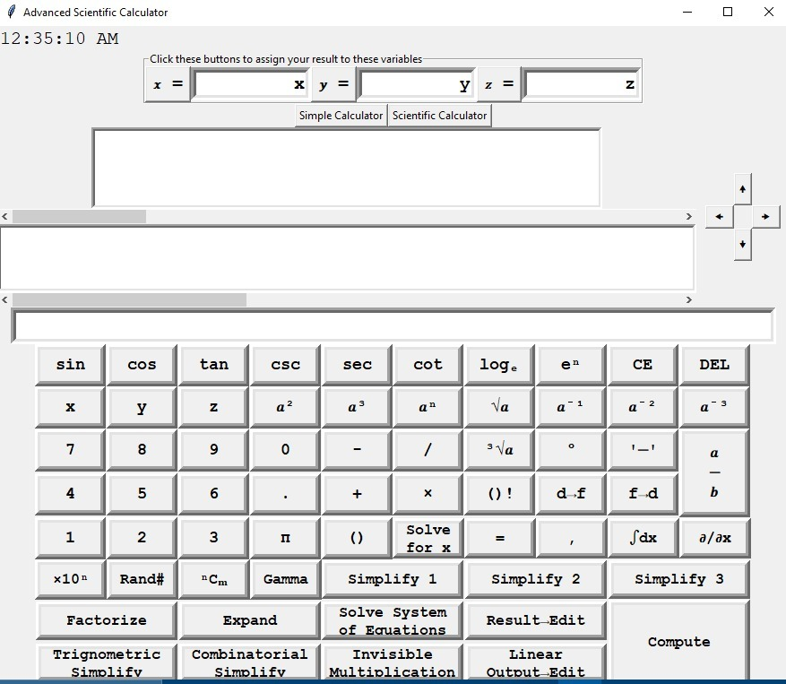
Scientific Fraculators with Extended Features

Slide 2


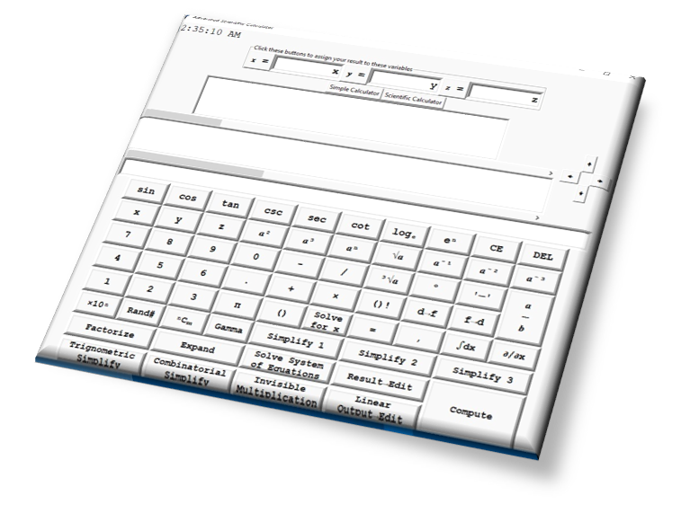
Important Features:
Natural style input display for powers, and fraction.
You can also use your keyboard instead of clicking display buttons.
Navigation keys for input
Beautifully supports both degree and radian input of angles
A separate single line output display.
Supports three symbols for variables x,y and z

Slide 3
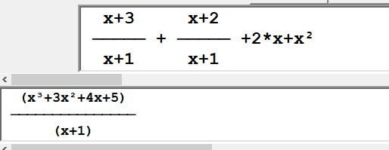
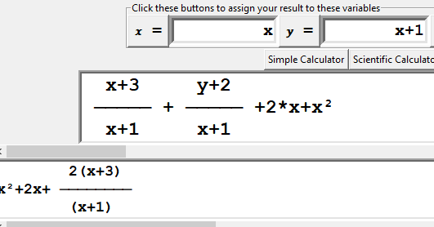
Uses tkinter, math, time and Sympy libraries
Have two output screens, one is multi-line fractional display and second one is linear display
Fractional display could display fractional output in natural format
Integration and differentiation

Slide 4
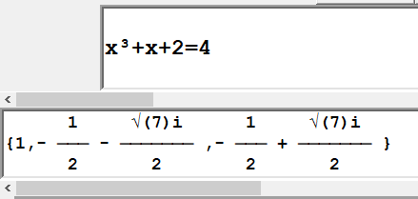
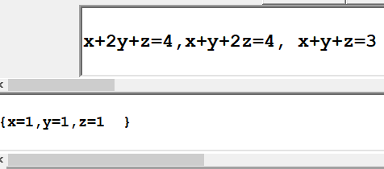
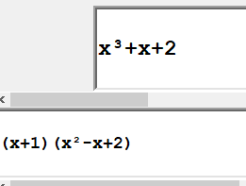
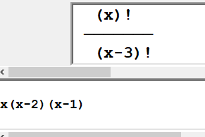
Solve a nonlinear equation in x
Solving system of linear and non-linear equations in multiple variables
LCM, cancel out numerator and denominator, and Simplify an expression in different ways of your choice
Factorize an expression
Compute and simplify Combinations, Factorials and Gamma function.
Invisible multiplication symbol could be used to give a better look to your display.

